Slide 1


Dept of ECE

Slide 2


Slide 3
Shrusti Slides

Slide 4

Dept of ECE

Slide 5
Rahul Slides

Slide 6
Overview of Pulp & Paper Industry Waste
Types of Waste Generated
Wastewater: Washing, pulping, bleaching.
Solid Waste: Handling, screening, sludge.
Air Emissions: Sulfur, SO₂, NOx.
Environmental Impact
Water: Pollution.
Soil: Contamination.
Air: Degradation.
Dept of ECE

Slide 7
Waste Audit Procedures
Wastewater Treatment Analysis
Primary: Clarifiers.
Biological: Aeration, sludge.
Segregation: Targeted.
Solid Waste Management
Reuse: Recycling.
Sludge: Dewatering.
Dept of ECE

Slide 8
Pollution Prevention Opportunities
Process Optimization
Water: Recycling.
Bleaching: Recirculation.
Housekeeping: Efficient.
Chemical Recovery Techniques
Black Liquor: Recovery.
Relime: Reuse.
Lime: Optimization.
Dept of ECE

Slide 9
Pollution Prevention Opportunities
Use of Alternative Raw Materials
Bagasse: Renewable.
Enzymes: Biodegradable.
Recycling: Fibers.
Dept of ECE

Slide 10
Waste Audits in the Electroplating Industry
Overview of Electroplating Industry Waste
Types: Cyanide, chromium, cadmium, solvents, sludges.
Impact: Groundwater, air, and soil contamination.
Waste Audit Procedures
Chemical Usage: Evaluate inefficiencies.
Wastewater: Analyze pollutants.
Pollution Prevention Opportunities
Process Modification: Optimize systems.
Recovery & Recycling: Reuse chemicals.
Non-toxic Alternatives: Safer substitutes.
Dept of ECE

Slide 11
Rakshita Slides

Slide 12
Overview of Tanning Industry Waste
Types of Waste Generated
Liquid Waste: Wastewater containing high levels of organic and inorganic contaminants.
Solid Waste: Fleshings, trimmings, and shavings.
Gaseous Emissions: Volatile organic compounds (VOCs) and odoriferous gases
Environmental Impact
Water Pollution: Discharge of untreated or poorly treated effluent.
Soil Contamination: Improper disposal of solid waste.
Air Pollution: Emission of VOCs and malodorous gases.
Biodiversity Loss: Impact on aquatic and terrestrial ecosystems.
Dept of CSE

Slide 13
Waste Audit Procedures
Monitoring Water and Chemical Usage
Water Usage
Measure water input and effluent output.
Optimize water recycling and reuse.
Chemical Usage
Maintain a detailed inventory of chemicals.
Substitute hazardous chemicals with eco-friendly alternatives.
Solid Waste Management
Segregation: Separate biodegradable, recyclable, and hazardous waste.
Recycling: Convert fleshings and shavings into value-added products.
Composting: Organic waste for soil amendment.
Disposal: Environmentally compliant disposal methods for non-recyclable waste.
Dept of CSE

Slide 14
Pollution Prevention Opportunities
Cleaner Production Techniques
Adoption of wet-white tanning to reduce chromium pollution.
Use of enzymes for dehairing instead of chemicals.
Efficient wastewater treatment technologies like membrane bioreactors.
Integration of renewable energy sources.
Waste Minimization Measures
Process Optimization: Enhance process control to minimize waste.
Raw Material Selection: Use high-quality hides to reduce rework and waste.
Lean Manufacturing: Eliminate unnecessary steps that generate waste.
Dept of CSE

Slide 15
Pollution Prevention Opportunities
Resource Recovery:
Water Recovery: Treat and reuse wastewater.
Chemical Recovery: Recover chromium and other chemicals for reuse.
Energy Recovery: Utilize biogas from anaerobic digestion of organic waste.
Material Recovery: Convert waste into useful by-products (e.g., gelatin from trimmings).
Dept of CSE

Slide 16
Overview of Dairy Industry Waste
Types of Waste Generated
Wastewater: Rich in fats, proteins, lactose, and cleaning agents.
Solid Waste: Includes sludge, packaging, and whey by-products.
Air Emissions: Odor and volatile organic compounds.
Environmental Impact
High BOD and COD affect water bodies.
Nutrient runoff leads to eutrophication.
Improper disposal contaminates soil and water.
Greenhouse gas emissions from energy use.
Dept of CSE

Slide 17
Waste Audit Procedures
Wastewater Management
Pre-treatment: Screening and removal of solids.
Primary treatment: Fats, oils, and grease (FOG) separation.
Biological treatment for organic content.
Advanced methods: Membrane filtration, wetlands.
Solid Waste Analysis
Categorize into recyclable, biodegradable, and hazardous.
Explore composting and animal feed options.
Minimize and recycle packaging waste.
Dept of CSE

Slide 18
Pollution Prevention Opportunities
Wastewater Treatment Innovations
Anaerobic digestion for biogas production.
Advanced oxidation for persistent pollutants.
Use of natural filtration systems like wetlands.
By-product Utilization
Convert whey into protein concentrates.
Use sludge in biogas plants or as fertilizer.
Recover milk solids for additional processing.
Dept of CSE

Slide 19
Pollution Prevention Opportunities
Energy Recovery
Biogas generation from organic waste.
Heat recovery systems for energy savings.
Implement combined heat and power (CHP) systems.
Dept of CSE

Slide 21
Kavya Slides

Slide 22
Dept of ECE

Slide 23

Anish Slides

Slide 24

Definition and Importance of Transboundary Movement of Hazardous Wastes
Definition: Transportation of hazardous waste across international borders for disposal, recycling, or treatment.
Importance:
Environmental Protection: Prevents pollution and protects ecosystems.
Public Health: Reduces health risks from toxic exposure.
Global Responsibility: Shared duty for sustainable waste management.
Economic Considerations: Avoids costly clean-up and legal liabilities.
Dept of ECE

Slide 25

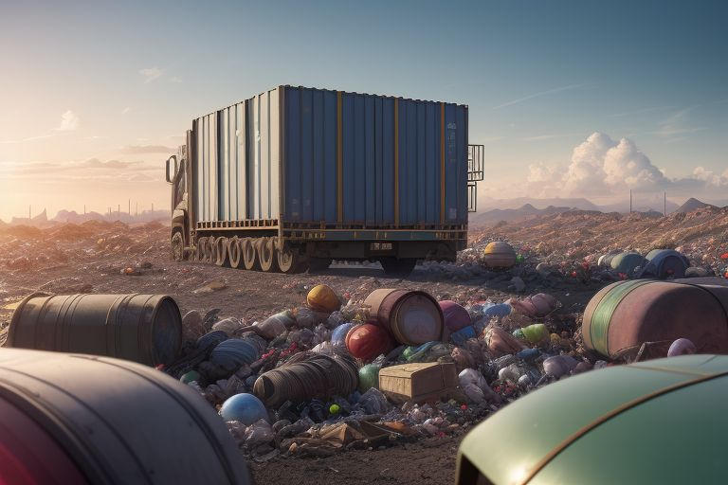
Regulations Governing Transboundary Movement
Basel Convention: Key treaty to reduce hazardous waste movement, requiring prior informed consent.
EU Waste Shipment Regulation: Governs waste movement within/outside the EU, ensuring environmentally sound management.
National Regulations: Countries have specific laws complementing international treaties.
Dept of ECE

Slide 26

Procedures for Compliance
Notification and Consent: Exporters must notify authorities and obtain consent from importing countries.
Documentation: Essential records include waste manifests and contracts.
Tracking and Reporting: Movement must be tracked and reported to ensure compliance.
Compliance with Destination Regulations: Ensure waste meets importing country standards.
Dept of ECE

Slide 27

Case Studies and Examples
Basel Convention Case: Illegal export of hazardous waste from the U.S. to Africa highlighted enforcement needs.
EU Waste Shipment Regulation Example: Legal actions against a member state for improper waste export.
E-Waste Trade: Significant issue with improper management leading to environmental and health impacts.
Dept of ECE

Slide 28
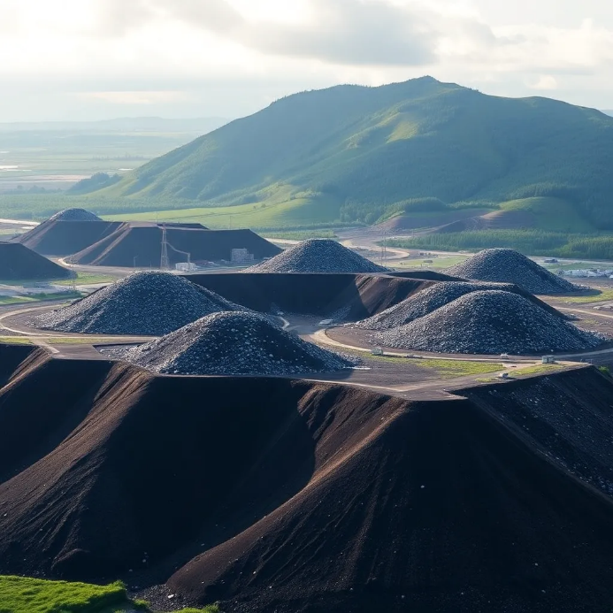
Overview of Disposal Methods
Landfill Disposal: Containment in engineered landfills; requires monitoring and strict regulations.
Incineration: High-temperature burning to reduce volume and toxicity; requires emission control.
Recycling and Recovery: Processing to reclaim resources; must comply with safety regulations.
Dept of ECE

Slide 29

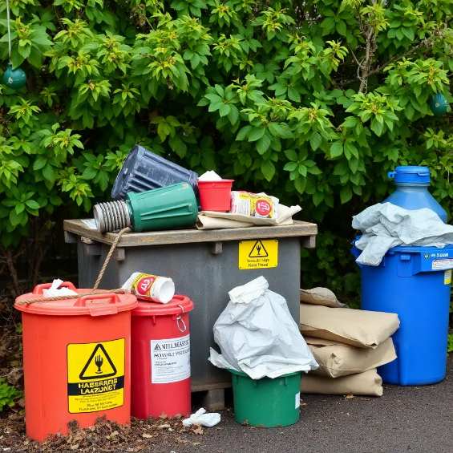
Best Practices for Hazardous Waste Disposal
Characterization: Identify waste composition and hazards.
Segregation: Separate hazardous from non-hazardous waste.
Documentation: Maintain thorough records for compliance.
Training: Educate personnel on safe handling and disposal.
Emergency Preparedness: Implement response plans for spills or accidents.
Dept of ECE

Slide 30
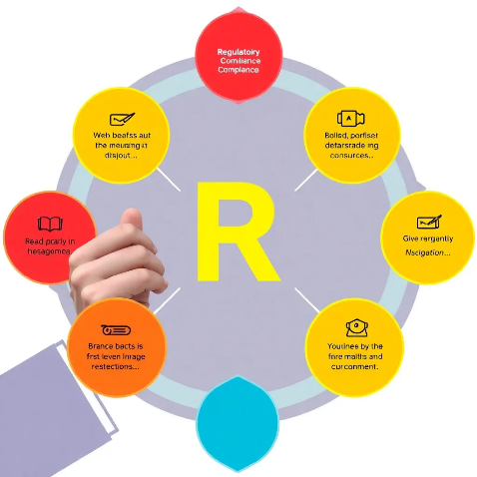
Regulatory Compliance and Standards
Overview: Compliance is essential for safe hazardous waste disposal.
Key Regulations:
RCRA: Governs hazardous waste management in the U.S.
Basel Convention: Regulates transboundary waste movement.
EU Waste Framework Directive: Sets waste management principles in the EU.
Compliance Requirements: Labeling, storage, disposal, and reporting standards.
Dept of ECE

Slide 31

Conclusion
Summary of Key Points: Effective disposal is crucial for health and environmental protection.
Importance of Waste Audits: Identify improvements and promote sustainability.
Call to Action for Industries: Develop comprehensive waste management plans and adopt pollution prevention measures.
Dept of ECE

Slide 32

Dept of ECE

Slide 33
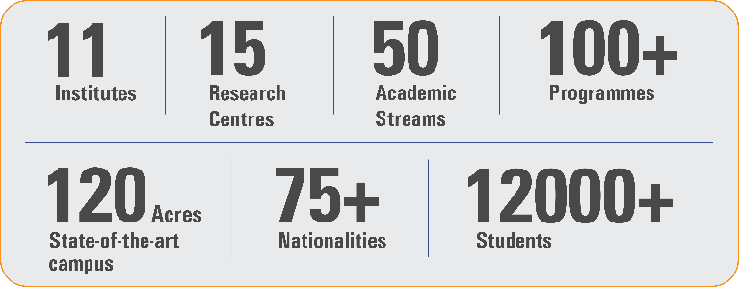
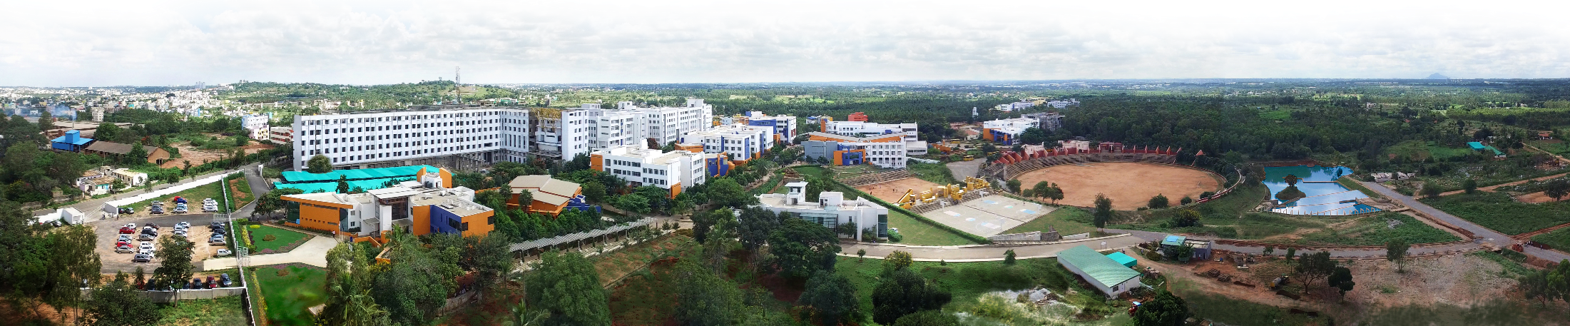
Overveiw
Acharya stands as a beacon of excellence in higher education, boasting a legacy of academic distinction since its establishment in 1990. We offer a transformative educational experience, fostering holistic development, nurturing innovation and providing world-class facilities to ensure an enriching journey for our students.
Dept of ECE

Slide 34

11 Institutions, Infinite Possibilities
We provide 100+ programs across 50 academic streams.
Dept of ECE

